Slide 1
How to Build Leaders Building Hope & Confidence
Presented by
Dr. Jordan B. Smith Jr.
And Ms. Karin Lee

Slide 2
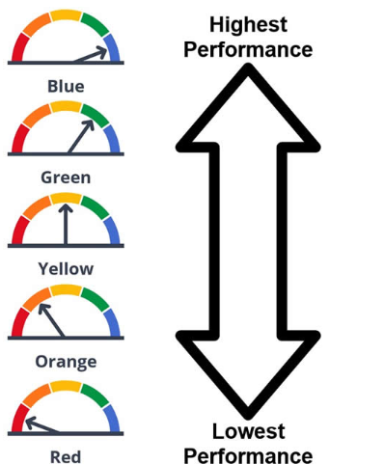
Like it or not the California Accountability Dashboard is here to stay and a continuation school staff must plan to monitor instruction and learning outcomes. Students and teachers are discovering strategies to overcome the fear of taking the 11th-grade summative assessment. We will share our strategies for preparing credit deficient students for the CAASPP using the SBAC digital resources incorporating expository writing, formative assessment, and technology to master essential standards for college and career readiness.

Slide 3
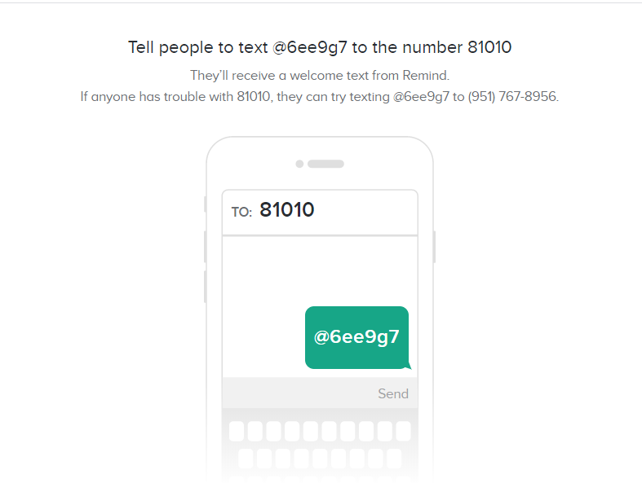
Notes:
This is a condensed presentation and you will be sent a link for access to both of our presentations.

Slide 4
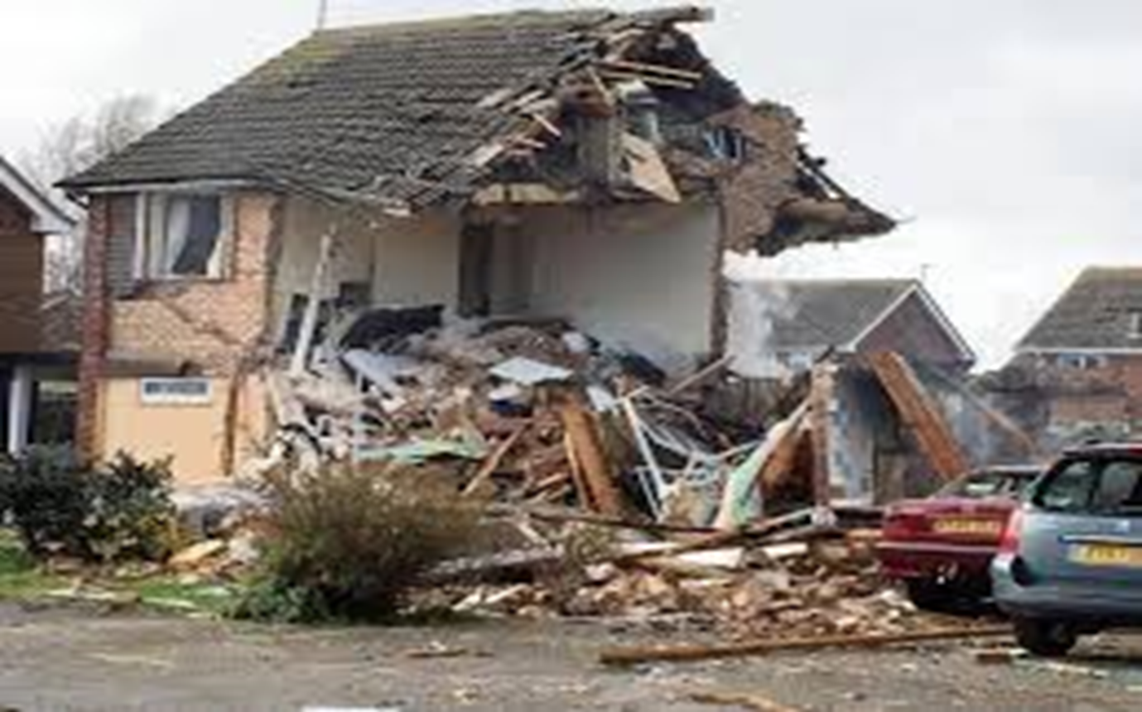
Once upon a time
This was my life
https://www.remind.com/join/6ee9g7
Notes:
In 1972 I entered the United States Naval Academy. I graduated in 1976 with letter of commendations. I achieved the rank of Captain (skipper) early. But forces at work against me would have me tumble and fall because I was passed over for the rank of Lt. Col and was force to leave at the rank of Major. Ironically with no retirement due but social security. The Marine Corps was my life. In 1996 I had to choose a different past from the United States Marine Corps. I struggled for 8 years being a web designer, webmaster, bartender, DJ, bar manager and karaoke host.
On Valentine Day in 2003 I met the love of my life Joyce who asked nothing of myself. She believed in me and accepted me for who I was at the time. I was very lucky. I was broke with no money in any bank. I had a 12 year old red jeep in need of repair and a paint job. I was on unemployment of $486 every two weeks. I had really bad credit. She on the other hand was a single mom who owned her home, owned a nice car and had a steady job supporting two adult kids and one grandson. What I did not know at the time was that I was about to marry Santa Claus. I mean really she was the only woman that I have ever known to have purchased and wrapped every present before Halloween. I mean you have to dust off the presents to place them under the tree.
I now realize today that I was just like the students who get transferred and report to our school each and every week. My wife was my counsellor that rebuilt a broken ship. In 2012 MV Alternative Schools had 112 graduates, last year in 2018 we had 278 graduates and this school year we have exceeded our monthly graduating totals 8 out of nine months.
So why am I sharing this story with you right now? I know that something is more important for us to straighten up and fly right. For 15 years ago i became a teacher to make a direct impact on student learning and now I realize that I am living that dream but the vision is still out of focus.

Slide 5
What’s Are Your Priorities?
In the fall of 2018 the results were devastating for most CCEA schools. So what’s more important?
Students graduating during their 4th year of high school
or
the accountability academic performance on a standardized test.

Slide 6
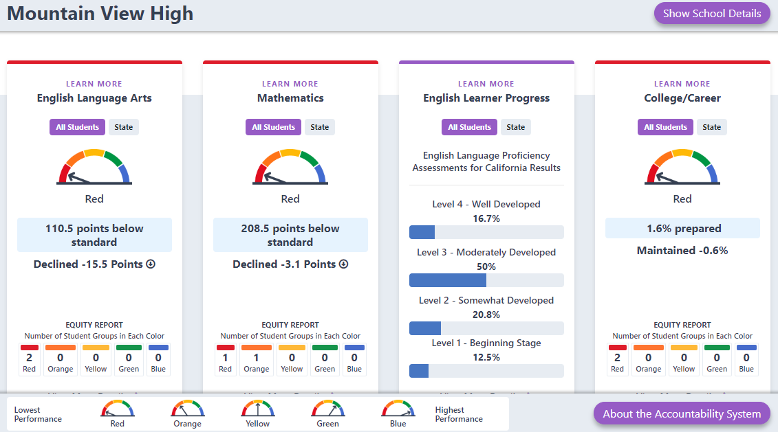

Slide 7
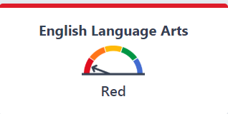
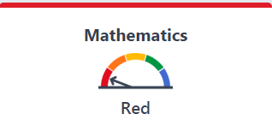
What do you notice and wonder?
ELA is in the Red
Math is in the Red
Excuses?
11th graders arrive with few credits in ELA & Math
11th graders arrive with deficient skills in ELA & Math
How do you teach 3 years of Math or ELA in ±11 months?
Can we prepare for the SBAC and Graduate them on Time?
What do we sacrifice?

Slide 8
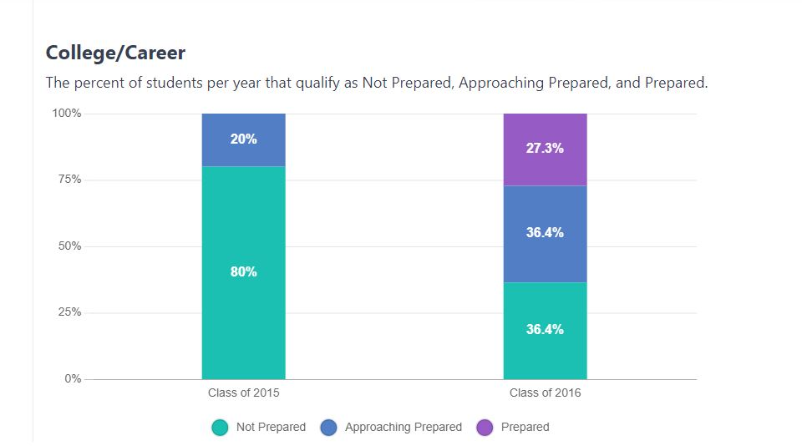
What did you wonder & notice?

Slide 9
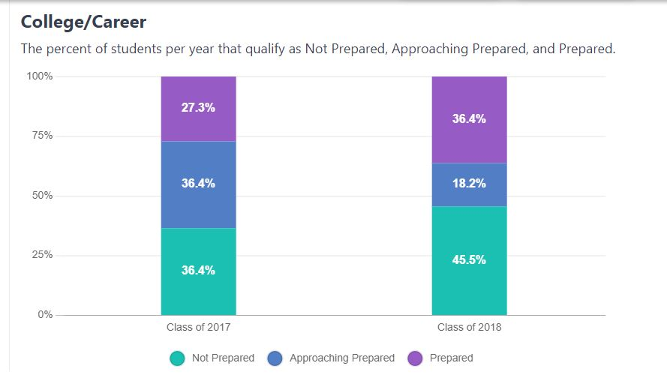
What did you wonder & notice?
How About An Unusual Approach?
ALL MEANS ALL
There has to be a solution. Right?
Is the dashboard going to go away? Yes or No?
Can anyone close the achievement gap? Is it possible?
Do you as a teacher have a fixed or growth mindset about your students?

Slide 10
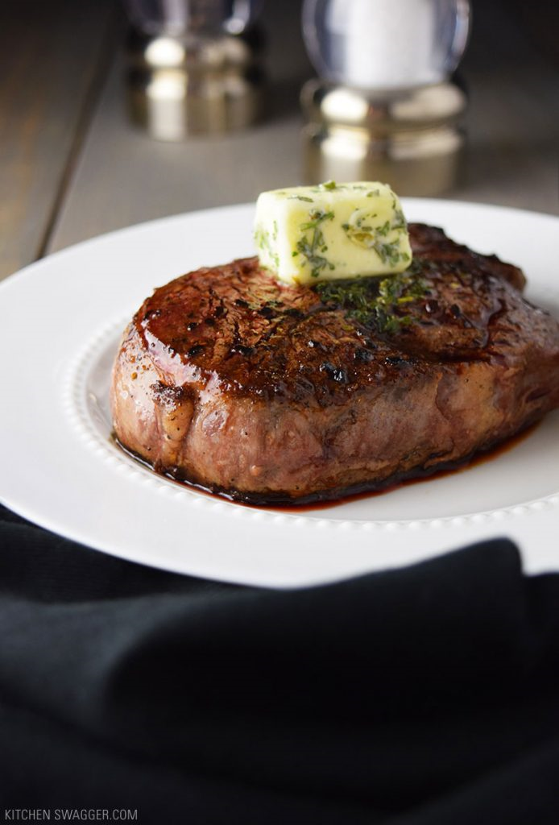
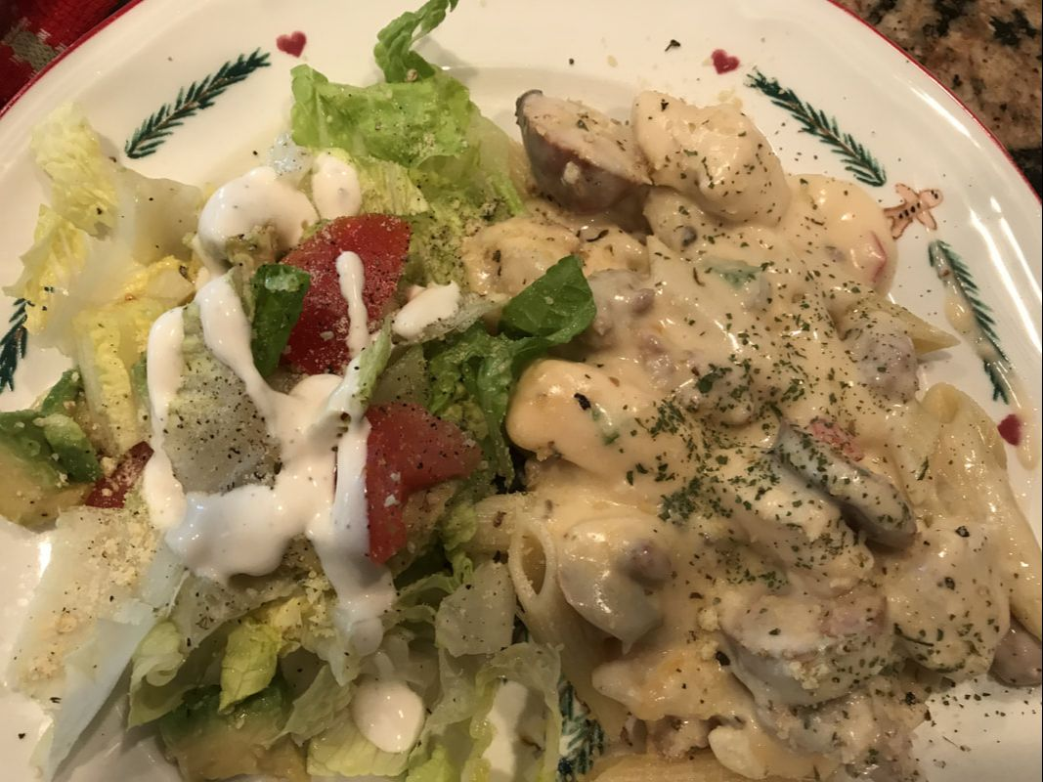
We Need a Good Recipe

Slide 11
A Recipe To
Make Improvements
Orientation (On-boarding)
Growth Mindset
Fixed Mindset
Learning Styles
Diagnostic Testing
Embedded Expository Writing
Close Reading Strategies
Performance Task Solving Strategies
Universal Design Tools
Student Feedback
Formative Assessments
Practice and Training Tests
School Calendar
Problem-Based Learning
ICA/IPT Testing IAB for Correcting Deficiencies Digital Library Resources PLC Time on the Calendar Data Analysis & Review Curriculum Design - Focus on Intentional Targets
Multiple Learning Platforms
Multiple Assessment Options
Demonstrate Proficiency
Desmos
TI Calculators
Benchmarks
Diagnostic Testing
RSOP
Key Ingredients -
Beyond the Content

Slide 12
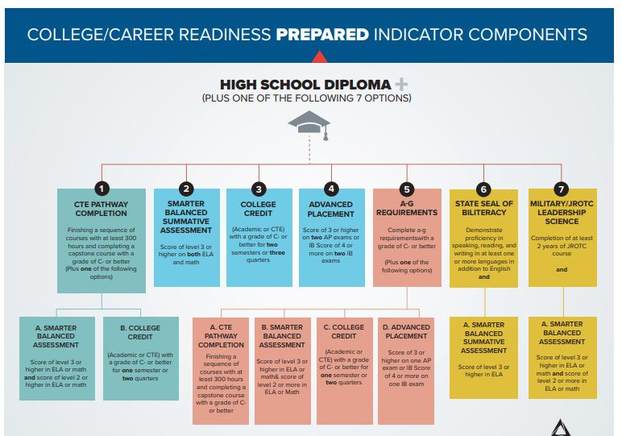
Understand Your Playing Field
What are the College and Career Readiness Indicators?

Slide 13
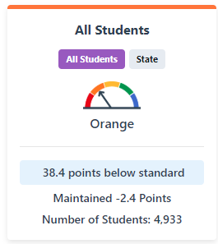
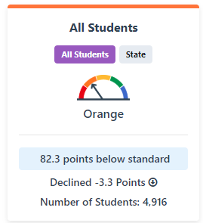
Dashboard - Academic Indicator
All Students
Explore how well students are meeting grade-level standards on the English Language Arts and Mathematic assessments. This measure is based on student performance on the Smarter Balanced Summative Assessment, which is taken annually by students in grades 3–8 and grade 11.
English Language Arts
Mathematics
Notes:
If a change is possible we need to focus upon our targets. Is it possible to show an increase?

Slide 14
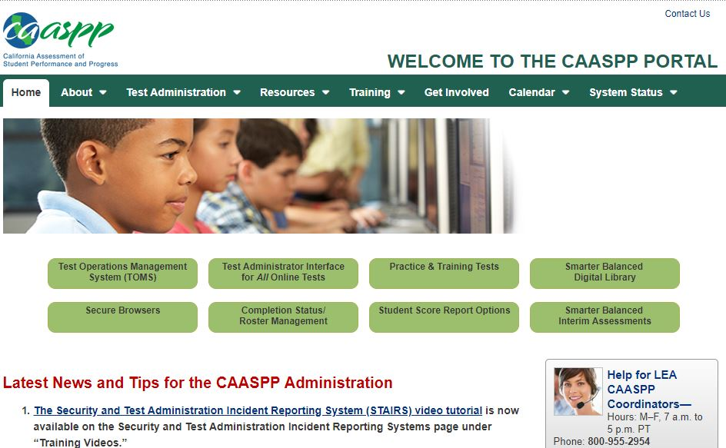

Slide 16
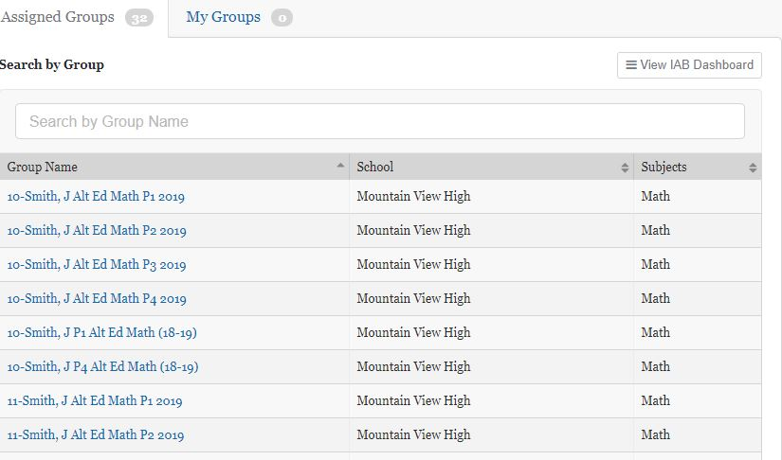

Slide 17
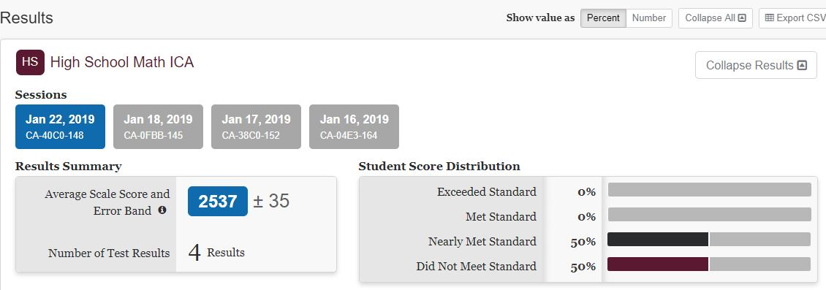

Slide 18
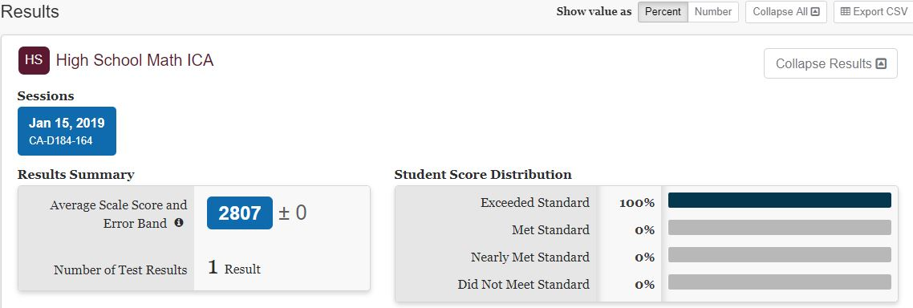

Slide 19
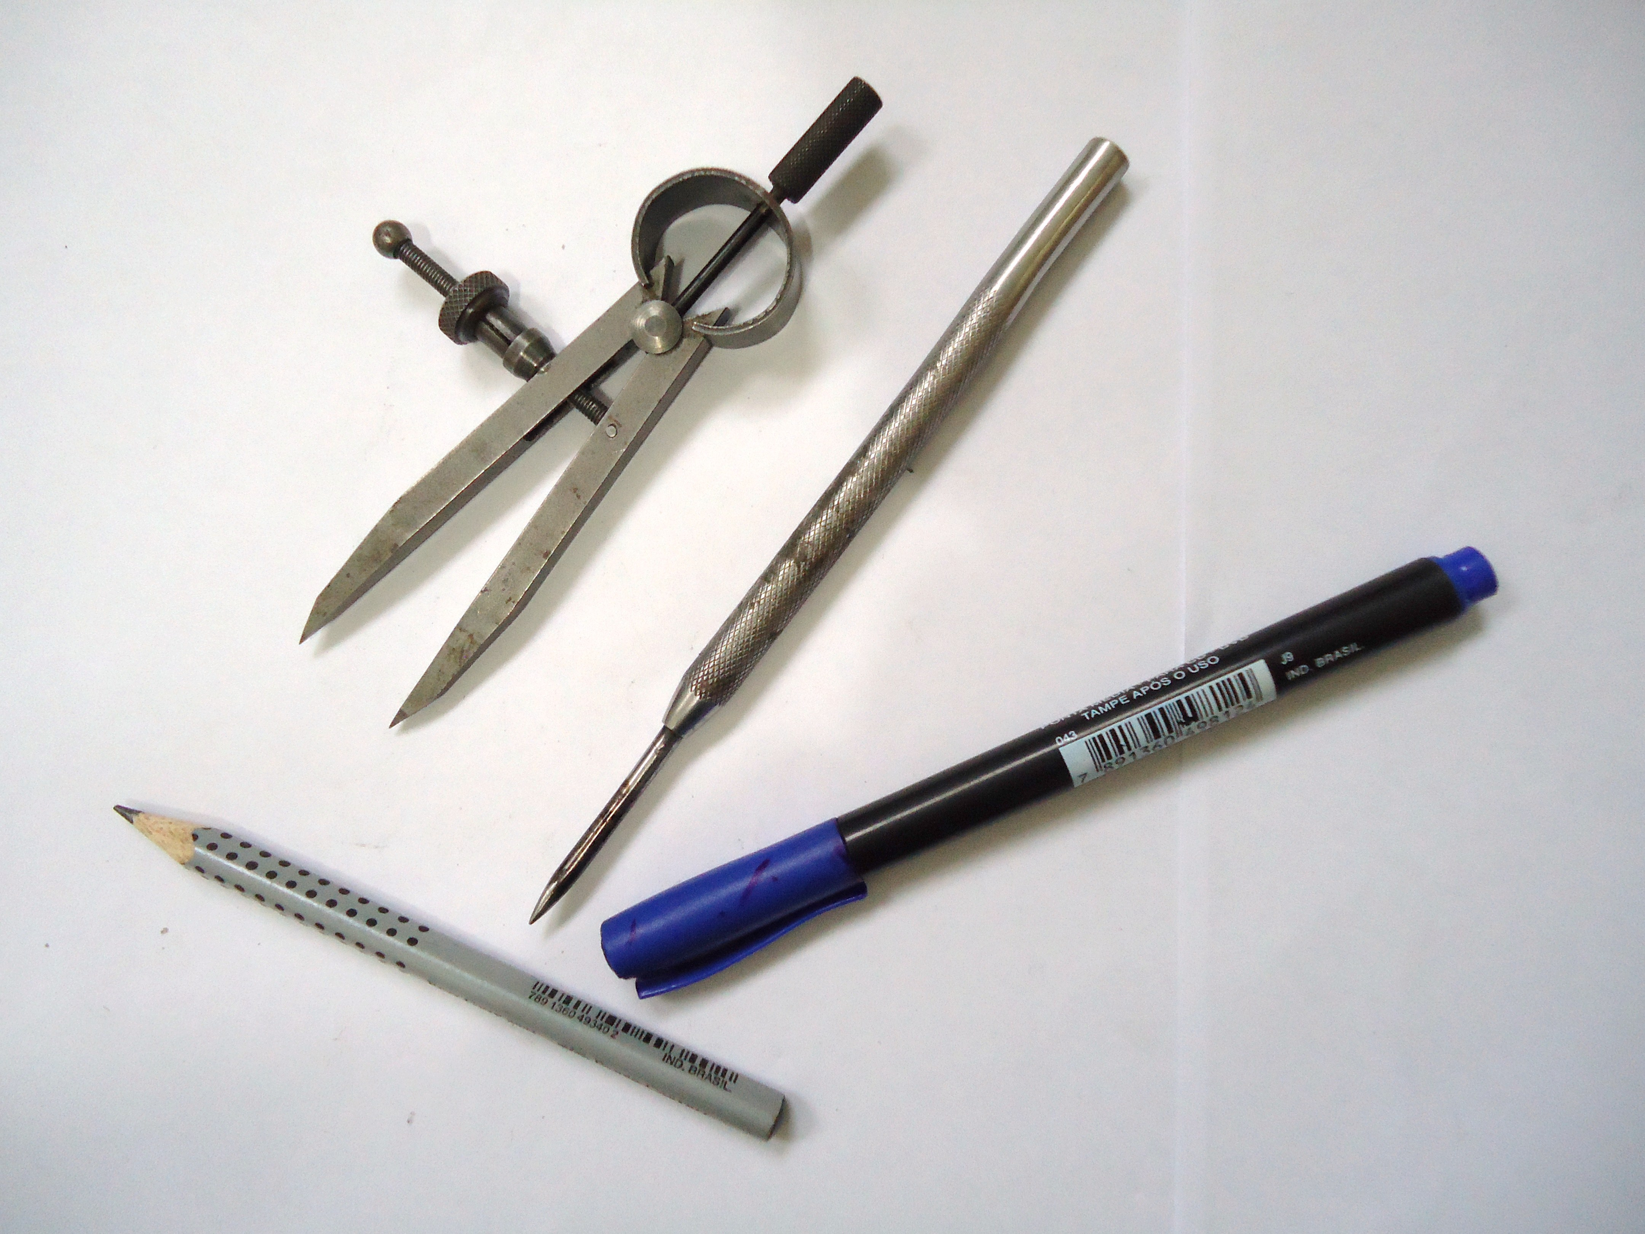
Effective Strategies
Diagnostic Tools
Formative Assessments Platforms
PLC Analysis in Action
Focus on Literacy

Slide 20
100% Diagnostic Testing
Focus on Learning Outcomes
WASC Preparations

Slide 21
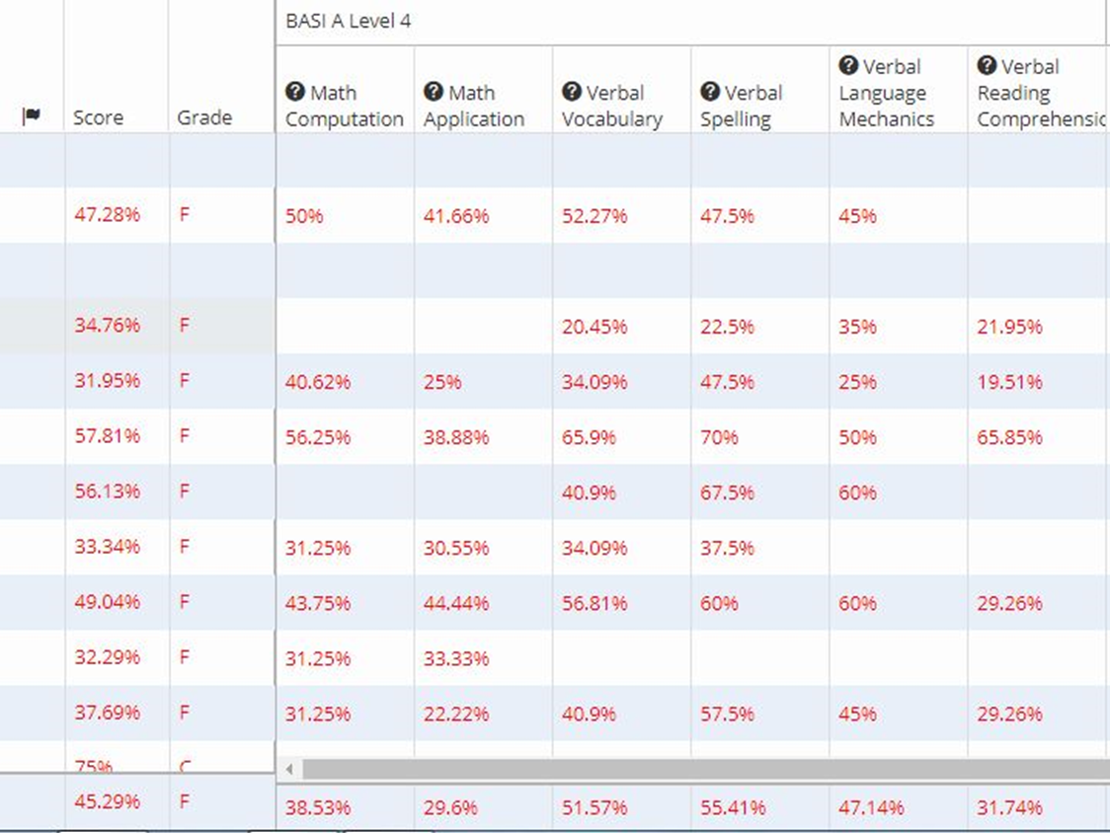

Slide 22
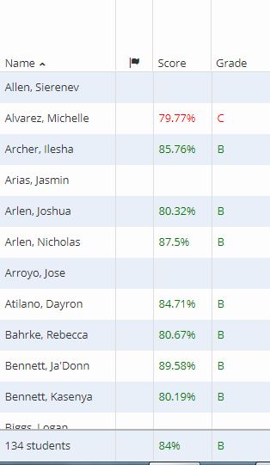

Slide 23
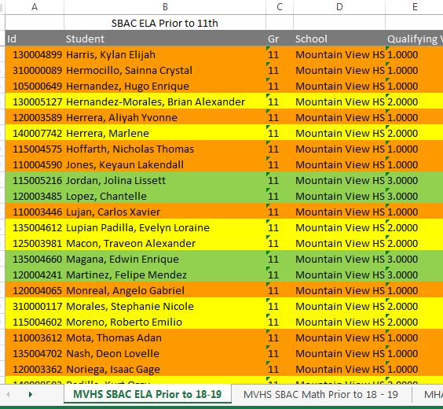

Slide 24
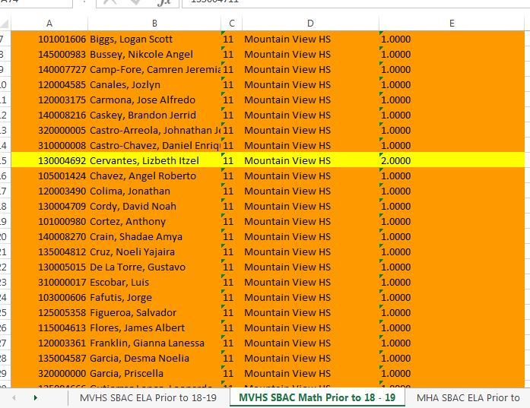

Slide 25
Family Engagement - Inclusion
Research consistently confirms that family engagement
is one of the most powerful predictors of children’s development, educational attainment, and success in
school and life.
So…
Notes:
LCFF - Priority 3: Parental Involvement (Engagement)
Efforts to seek parent input in decision making, promotion of parent participation in programs for unduplicated pupils and special need subgroups as relates to:
Culture and Climate
Equity
Family and Community

Slide 26
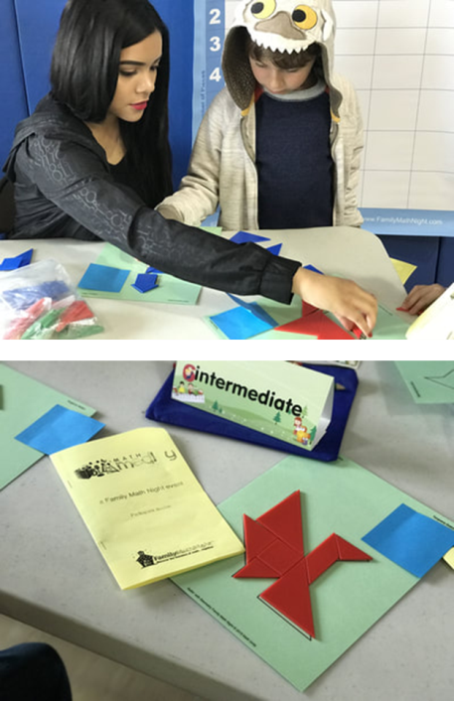
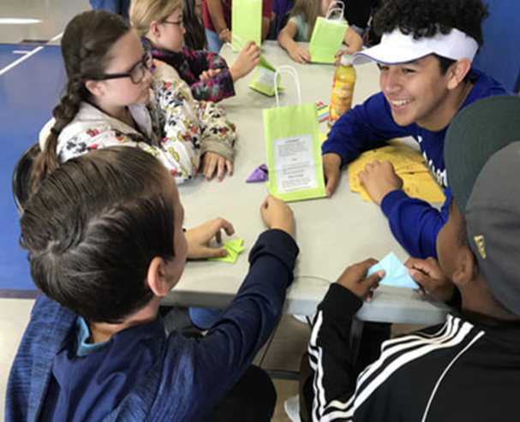
Family Math Nights
In 2017 Dr. Smith attended the NCTM
conference and went to a presentation on
Family Math Night, we implemented it last year
with the adjoining elementary school.
We trained our students to facilitate the games and then invited the K-5 graders to come on our campus and play the games. It was a roaring success. So this year we have expanded into
Family Math Nights – bringing in the parents and having the students play the games with them and their students.

Slide 27
Derive Your Essential Concepts
Keep it A-G teach all the standards
Make a Decision about What are Essential Learning Take-Aways
Assess student mastery (80% or higher) of Essential Concepts
Use Current Research - NCTM (2018) Like “Catalyzing Change for High School”
Maintain rigor of mastery level for essential standards
Use Project Based Learning Tasks - Cross Curricula Tasks (9 Week- Multi-Course)

Slide 28
Orientation
Every student requires on-boarding and an orientation to the learning materials
Textbook - You must teach them everything about the text book - Don’t Assume
Online Curriculum - You Must teach them how to use it. That means you have to do it first and then share and document the effective learning strategies.
Mindset Inventory - If Fixed - then Youcubed First
Learning Style Inventory - You and the Student Must know their best way for learning. Give feedback using their dominant learning style.
Diagnostic Testing - 100% of students. Set Goal for 11th Graders. Scheduled three times a year

Slide 29
Reading & Writing
Every subject requires and embeds writing task
Augmenative & Expository Minimum for SBAC
Teach Close Reading Strategies and use Daily
Teach Performance Task Solving Strategies
Provide Feedback to Move Learning Forward

Slide 30
Demonstration of Proficiency
Use Multiple Platforms for Learning (Learnbop, Pearson, Edmentum, Edgenuity, etc)
Use student voice in co-creation of assessments
Let students choose topics for research papers
Use multiple ways to demonstrate critical thinking

Slide 31
Technology Integration and Use
ICA/IPT Testing
IAB for Correcting Deficiencies
Digital Library Resources
Practice and Training Tests
Use of Desmos Calculator and Tasks

Slide 32
Schedule on School Calendar
Make PLC Time a Reality – Put It on the School Calendar
Put ICA/IAB on the School Calendar
Put Performance Tasks on the Calendar (3-4 Times a year)
Schedule Diagnostic Testing (3-4 Times a Year)
Schedule Cross-Curricula School Wide Project (9 Week Quarter)

Slide 33
Can your students explain what they are doing?
Dr. Smith uses ‘This Day in History’–
daily exposure (Mary Carr T2T)
Close reading strategies (Fisher & Frey, 2014)
Includes Daily Reading & Literacy Focus
A main focus for the last few years
has been having the students show reasoning and knowledge by writing.
We do that by using a variety of resources and strategies such as

Slide 34
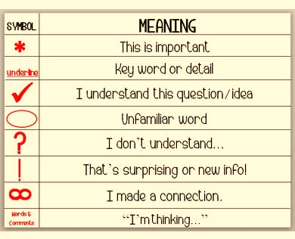
MVHS Math Close Reading Strategy
Read it Silently
Read It Once Again (Out loud if necessary)
Number Every Line
Underline what’s important
Circle Every Number (Words about Math)
Ask yourself what is this about and what are they asking you to find?
What strategy will I use to solve the problem?
Rewrite using the strategies!
Notes:
Pick one of the four and work through these steps and rewrite in your words.

Slide 35
COLOSO - Writing Workshop
CONTENT OBJECTIVE:
Be able to understand the importance of literacy & writing in mathematics, how to close read complex tasks in mathematics, Jane Shaffer expository writing format, and how to make math fun and culturally inclusive]
LANGUAGE OBJECTIVE:
Verbally and in writing describe close reading for mathematics strategy, the six entry format for a daily math writing journal and an expository writing summary. Write an entry into your Math Journal
SOCIAL OBJECTIVE:
Pair-Share with a partner; Small Group Discussion; Classroom Discussion; My Math Journal
(Hattie, Fisher, Frey, 2017)
Notes:
So we asked the students what they believe this says and we got….

Slide 36
Student COLOSO Journal
What are you learning today?
Why am I learning this?
How are you going to learn it?
How will you know that you got it?
Where can you get help if you don’t get it?
What evidence do you have that you are learning something today?

Slide 37
What is Math Literacy? What does it consist of? Why is it important?
ELA Literacy Standards
College and Career Readiness Anchor Standards
ELPAC Testing
SBAAC Preparations
Performance Tasks
Standards of Mathematical Practices
Teaching Practices for Mathematics
Accrediting Commission for Schools Western Association of Schools and Colleges –
Focus on Learning
Take a moment to discuss with the
person next to you.

Slide 38
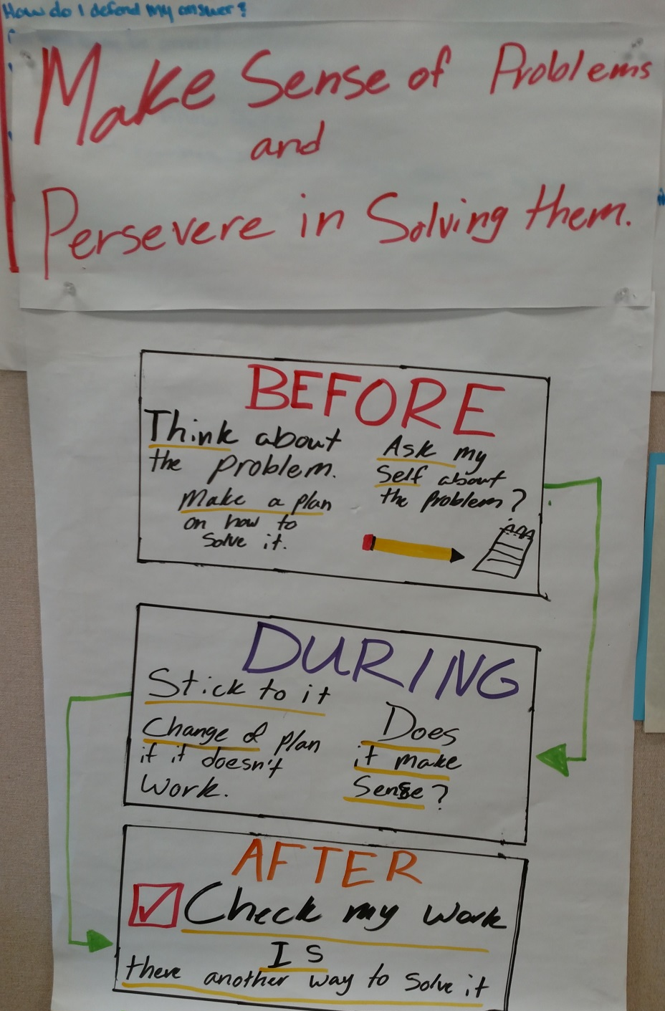
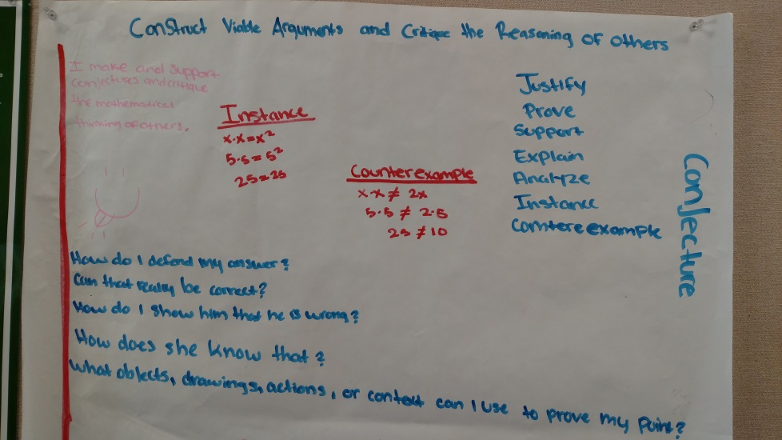
Student examples

Slide 39
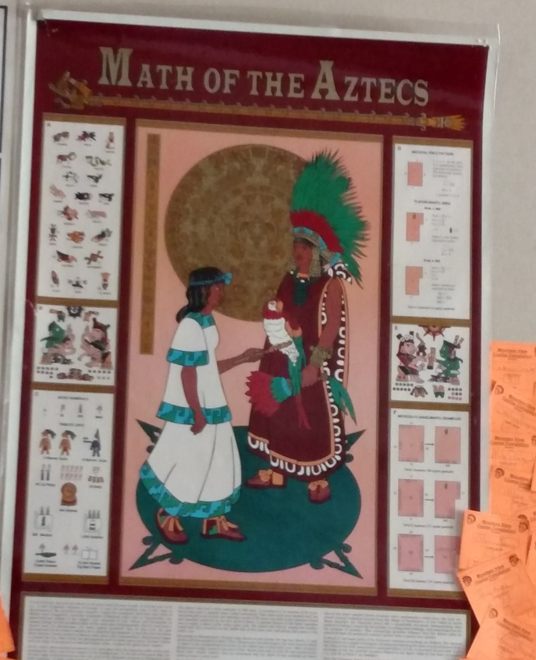
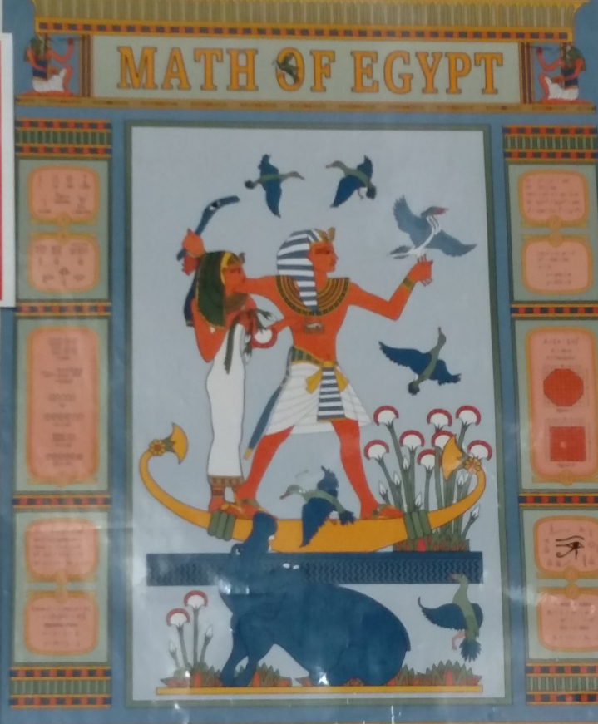
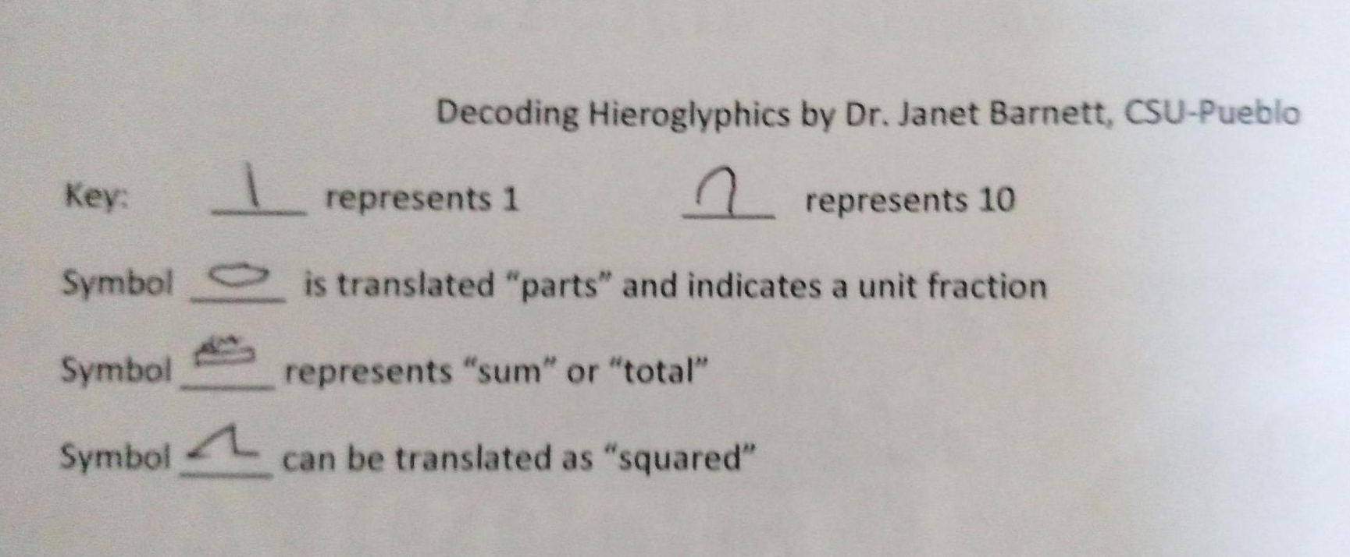
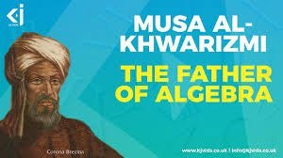
History
A new path is I have recently started using to engage the kids in the
“Why”
is to have them look at history!!

Slide 40
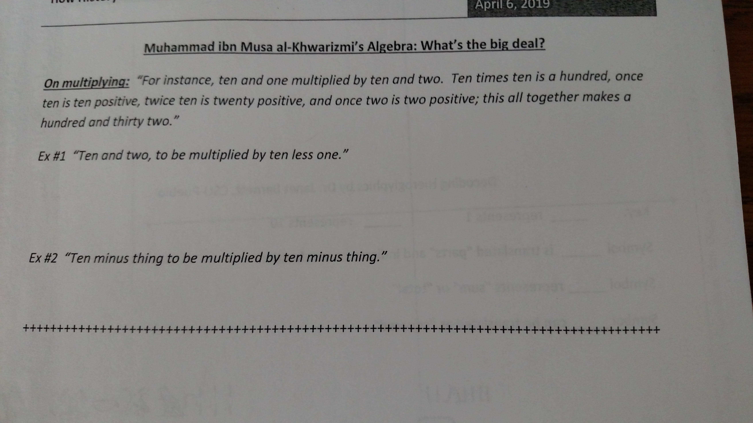
The multiplying process
10x10 = 100
1x10 =10
2x10= 20
1x2 = 2
132
The multiplying process
10x10 = 100
-1x10 =-10
2x10= 20
-1x2 = -2
118
Eventually leading to
(10 – x)(10 –x)
Which can be distributed or use the FOIL method.

Slide 41
2019-2020 CAASPP Assessment Planning
Smarter Balance Interim Assessment – Teacher & Student
Take, Review and Reflect on ELA Practice & Training Test
Take, Review and Reflect on Math Practice Test & Training Test
Take, Review and Reflect on Student Interface Practice and Training Tests
Teacher Identify Key Concepts to modify instruction and assessments throughout the year
Requires Time & Money
Teacher Professional Development (Self-Directed)
Design curriculum and instruction to match essential concepts for summative assessments.
On-going Diagnostic to address skill deficiencies while going through core SBAC content
On-Going Continuous Exposure (Orientation +Onboarding)
9th Graders ICA/IAB integrated in curriculum + Diagnostic (3-4 times a year)+ PBL/PT
1oth Graders ICA/IAB integrated in curriculum + Diagnostic (3-4 times a year)+PBL/PT
11th Graders ICA/IAB + Diagnostic= ICA/IAB Focused Review
Notes:
Our biggest fear and disappointment was that the alternative assessment dashboard was to be different. We thought it was going to address the issues of students coming to us as 10th and 11th graders and having to take an 11th grade assessment. Clearly we could not be graded the same. In the fall of 2018 the results were devastating. So what’s more important? Students graduating during their 4th year of high school or the accountability dashboard?

Slide 42
All Means All – Develop Teacher Leaders with A Growth Mindset

Slide 43
Once upon a time
https://www.remind.com/join/6ee9g7
Notes:
In 1972 I entered the United States Naval Academy. I graduated in 1976 with letter of commendations. I achieved the rank of Captain (skipper) early. But forces at work against me would have me tumble and fall because I was passed over for the rank of Lt. Col and was force to leave at the rank of Major. Ironically with no retirement due but social security. The Marine Corps was my life. In 1996 I had to choose a different past from the United States Marine Corps. I struggled for 8 years being a web designer, webmaster, bartender, DJ, bar manager and karaoke host.
On Valentine Day in 2003 I met the love of my life Joyce who asked nothing of myself. She believed in me and accepted me for who I was at the time. I was very lucky. I was broke with no money in any bank. I had a 12 year old red jeep in need of repair and a paint job. I was on unemployment of $486 every two weeks. I had really bad credit. She on the other hand was a single mom who owned her home, owned a nice car and had a steady job supporting two adult kids and one grandson. What I did not know at the time was that I was about to marry Santa Claus. I mean really she was the only woman that I have ever known to have purchased and wrapped every present before Halloween. I mean you have to dust off the presents to place them under the tree.
I now realize today that I was just like the students who get transferred and report to our school each and every week. My wife was my counsellor that rebuilt a broken ship. In 2012 MV Alternative Schools had 112 graduates, last year in 2018 we had 278 graduates and this school year we have exceeded our monthly graduating totals 8 out of nine months.
So why am I sharing this story with you right now? I know that something is more important for us to straighten up and fly right. For 15 years ago i became a teacher to make a direct impact on student learning and now I realize that I am living that dream but the vision is still out of focus.

